Slide 1
Introduction to the C Language
Objectives
❏ To understand the structure of a C-language program.
❏ To write your first C program.
❏ To introduce the include preprocessor command.
❏ To be able to create good identifiers for objects in a program.
❏ To be able to list, describe, and use the C basic data types.
❏ To be able to create and use variables and constants.
❏ To understand input and output concepts.
❏ To be able to use simple input and output statements.

Slide 2
Background
C is a structured programming language. It is considered a high-level language because it allows the programmer to concentrate on the problem at hand and not worry about the machine that the program will be using. That is another reason why it is used by software developers whose applications have to run on many different hardware platforms.
Notes:
Developed early 1970’s

Slide 3
C Programs
It's time to write your first C program.
Topics discussed in this section:
Structure of a C Program
Your First C Program
Comments
The Greeting Program

Slide 4
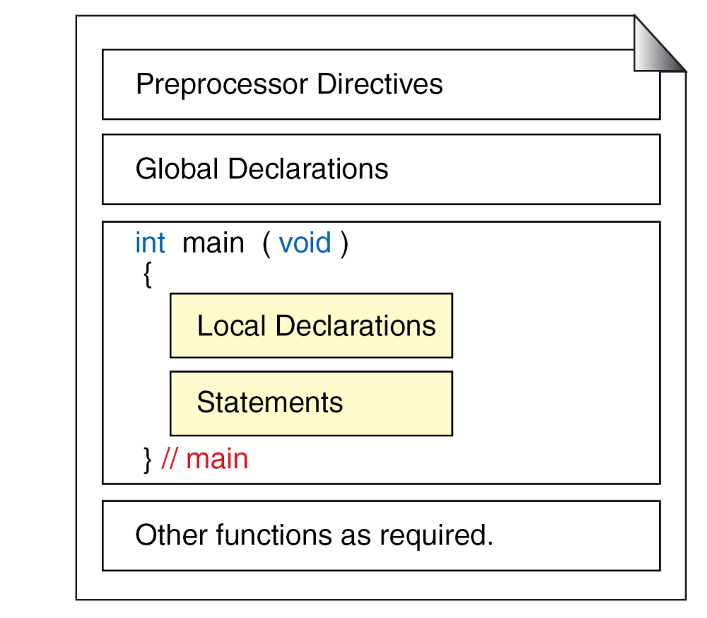
Structure of a C Program

Slide 5
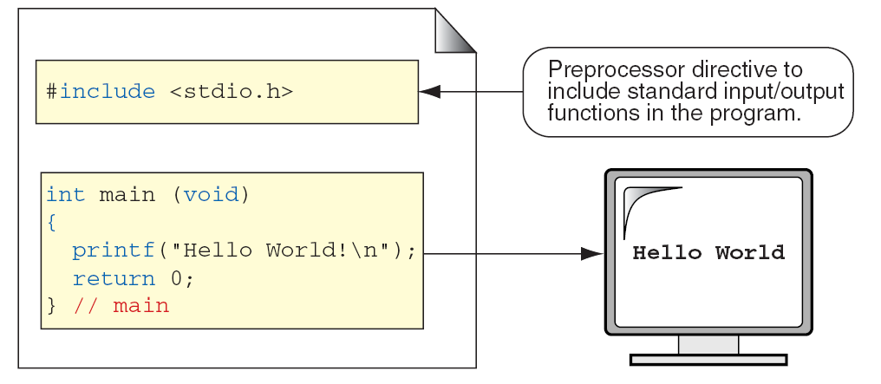
The Greeting Program

Slide 6
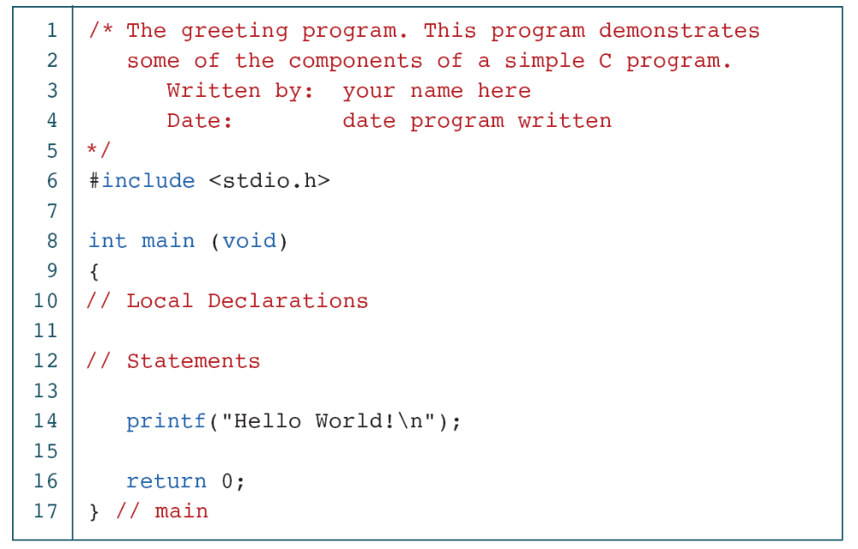
The Greeting Program

Slide 7
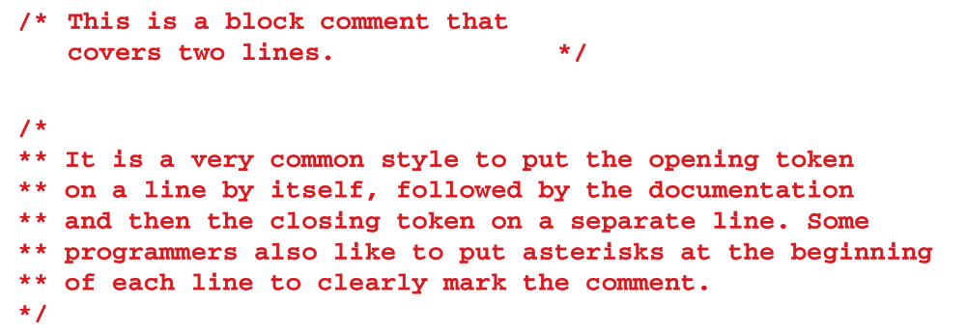
Examples of Block Comments

Slide 8
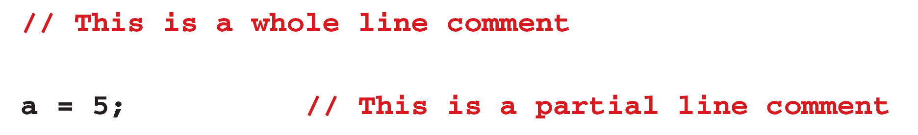
Examples of Line Comments

Slide 9
Identifiers
One feature present in all computer languages is the identifier. Identifiers allow us to name data and other objects in the program. Each identified object in the computer is stored at a unique address.

Slide 10
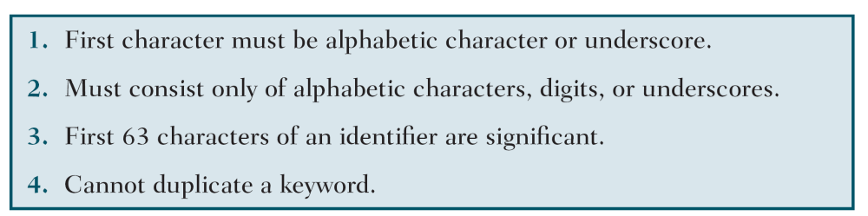
Rules for Identifiers

Slide 11
Note
C is a case-sensitive language.

Slide 12
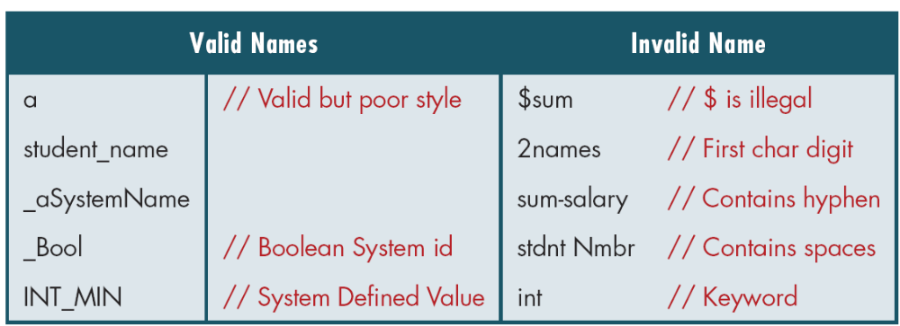
Examples of Valid and Invalid Names

Slide 13
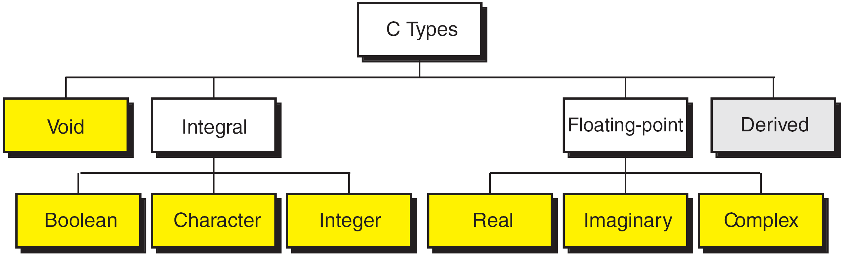
Data Types

Slide 14
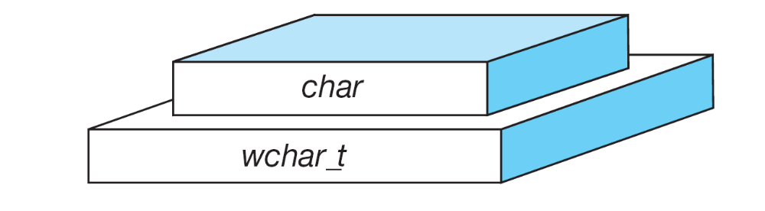
Character Types
Notes:
wchar_t is a wide character: The increased datatype size allows for the use of larger coded character sets. Width is compiler specific (not portable).

Slide 15
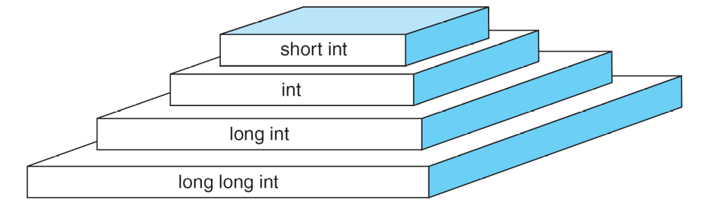
Integer Types

Slide 16
Note
sizeof (short) ≤ sizeof (int) ≤ sizeof (long) ≤ sizeof (long long)

Slide 17
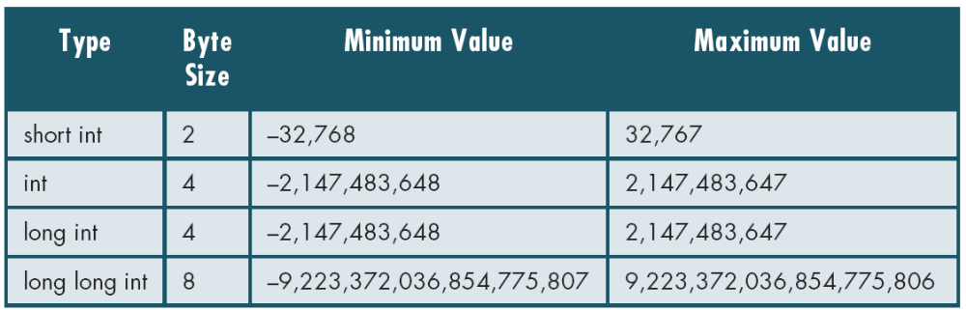
Typical Integer Sizes and Values for Signed Integers

Slide 18
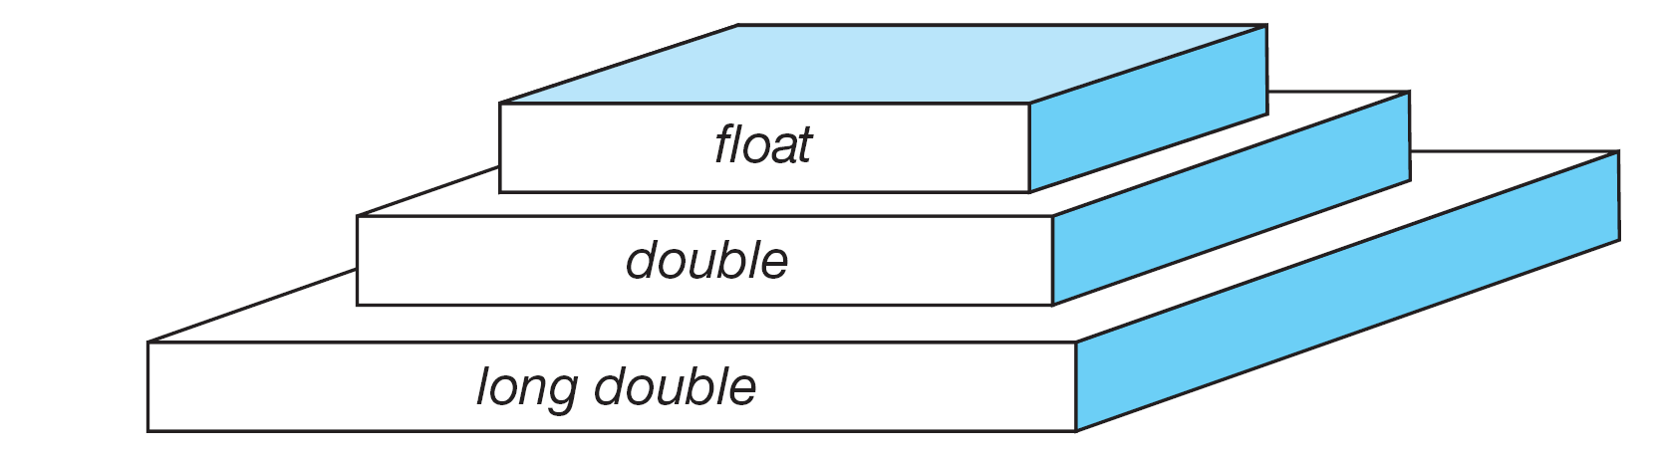
Floating-point Types

Slide 19
Note
sizeof (float) ≤ sizeof (double) ≤ sizeof (long double)

Slide 20
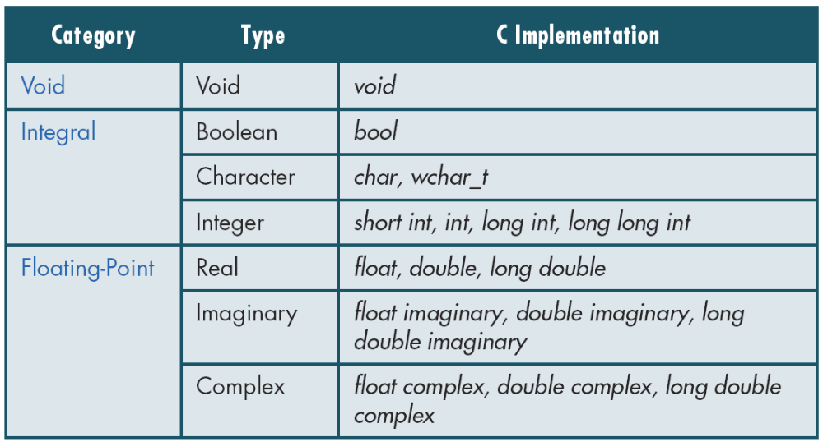
Type Summary

Slide 21
Variables
Variables are named memory locations that have a type, such as integer or character, which is inherited from their type. The type determines the values that a variable may contain and the operations that may be used with its values.
Topics discussed in this section:
Variable Declaration
Variable Initialization

Slide 22
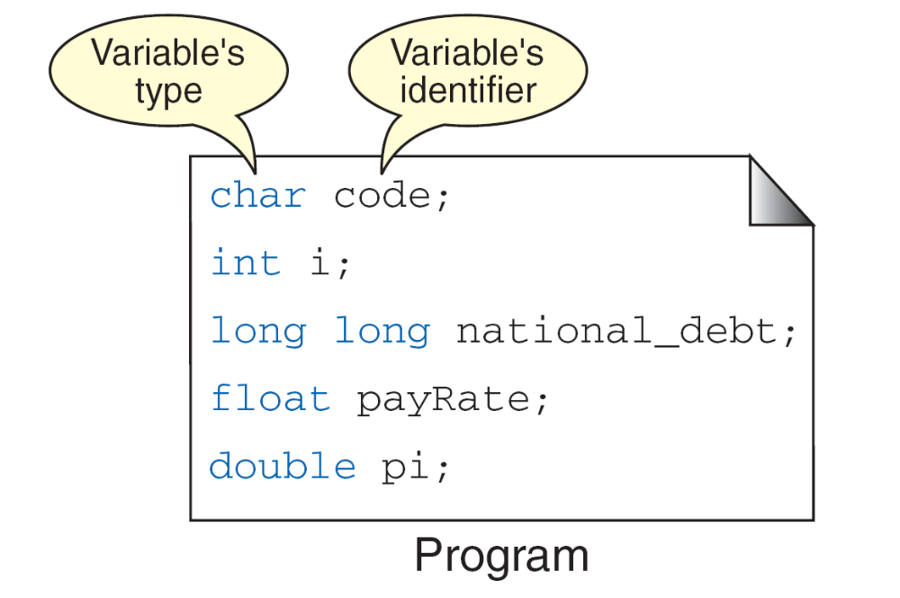
Variables

Slide 23
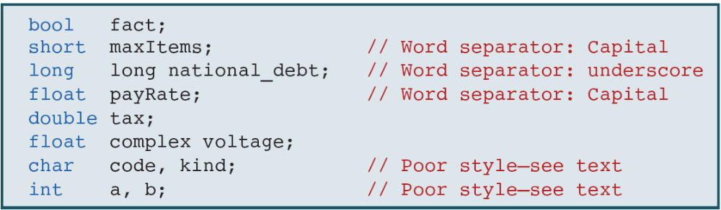
Examples of Variable Declarations and Definitions

Slide 24
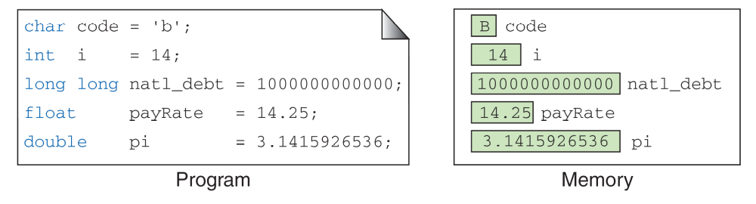
‘B’
Variable Initialization

Slide 25
Constants
Constants are data values that cannot be changed during the execution of a program. Like variables, constants have a type. In this section, we discuss Boolean, character, integer, real, complex, and string constants.
Topics discussed in this section:
Constant Representation
Coding Constants

Slide 26
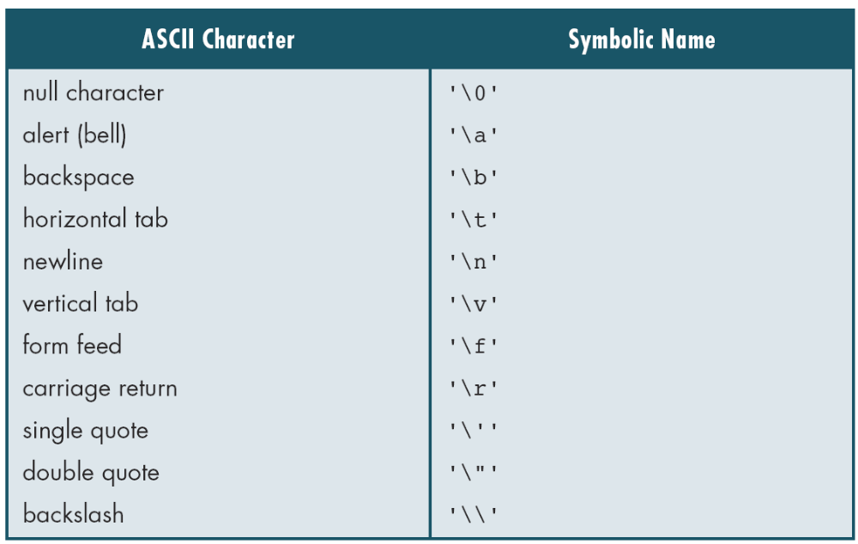
Symbolic Names for Control Characters

Slide 27
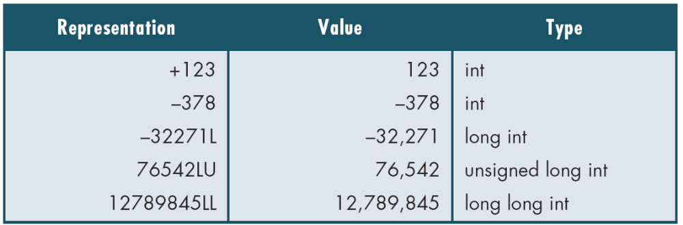
Examples of Integer Constants

Slide 28
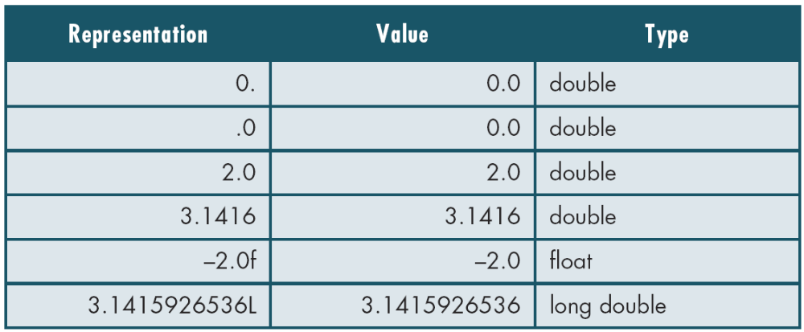
Examples of Real Constants

